Slide 1

NUgram
A new way for Northeastern students to connect
By: Noah Foilb and Harshith Umesh

Slide 2
Table of Content
Application Description – N.F
Data Schema/ Logical design – N.F
CRUD Demonstrations – H.U
C – Create a User
R – Read a Message
U – Update a User Profile
D – Delete a Like

Slide 3
NUgram Application Description
Engaging social platform just for Northeastern students.
Students can post, message, join groups, etc.
NU gram will make it easier for students to stay informed about campus event.

Slide 4
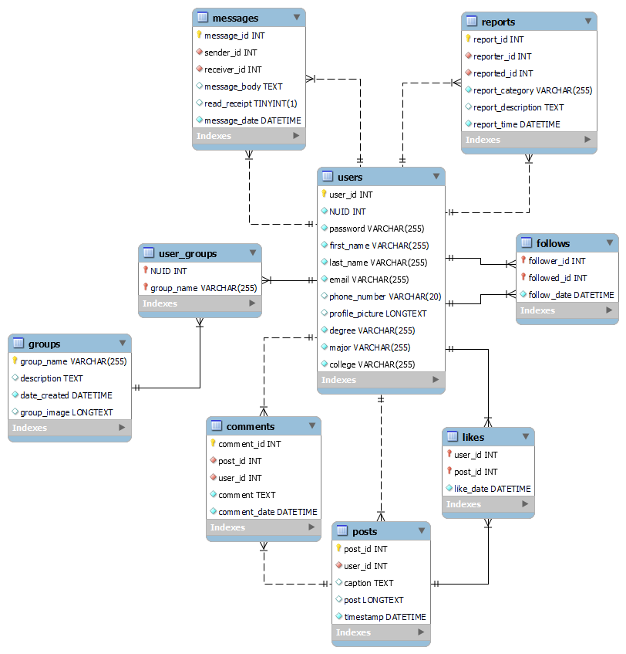
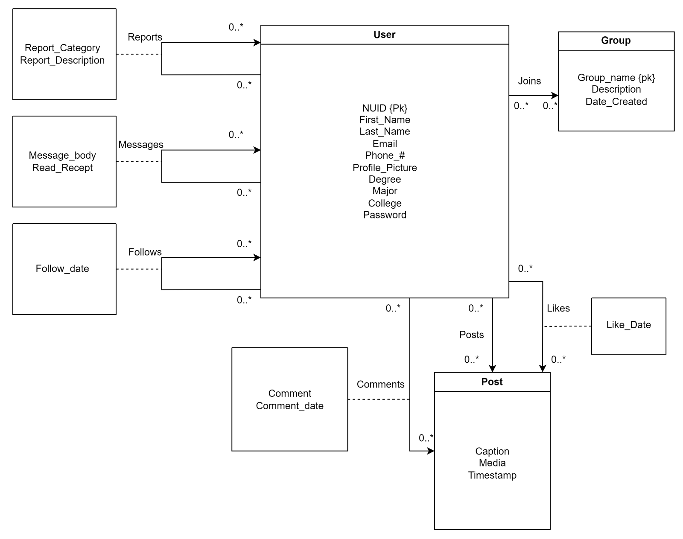
Data Schema/ Logical Design

Slide 5
C – Create a new User
CREATE PROCEDURE InsertUser(
IN p_NUID VARCHAR(255),
IN p_first_name VARCHAR(255),
IN p_last_name VARCHAR(255),
IN p_email VARCHAR(255),
IN p_phone_number VARCHAR(20),
IN p_profile_picture LONGTEXT,
IN p_degree VARCHAR(255),
IN p_major VARCHAR(255),
IN p_college VARCHAR(255),
IN p_password VARCHAR(255)
)
BEGIN
INSERT INTO Users (NUID, first_name, last_name, email, phone_number, profile_picture, degree, major, college, password)
VALUES (p_NUID, p_first_name, p_last_name, p_email, p_phone_number, p_profile_picture, p_degree, p_major, p_college, p_password);
SELECT LAST_INSERT_ID();
END //
cursor = connection.cursor()
cursor.callproc('InsertUser', [
data['NUID'],
data['first_name'],
data['last_name'],
data['email'],
data['phone_number'],
data['profile_picture'],
data['degree'],
data['major'],
data['college'],
data['password'],
])

Slide 6
R – Read a Report
CREATE PROCEDURE GetReportsByUserId(IN input_user_id INT)
BEGIN
SELECT * FROM Reports WHERE reporter_id = input_user_id ORDER BY report_time DESC;
END //
cursor = connection.cursor(dictionary=True)
cursor.callproc('GetReportsByUserId', [userId])

Slide 7
U– Update a User
CREATE PROCEDURE UpdateUser(IN user_id_param INT, IN field_param VARCHAR(64), IN value_param VARCHAR(255))
BEGIN
SET @query = CONCAT('UPDATE Users SET ', field_param, ' = ? WHERE user_id = ?');
SET @value = value_param;
SET @u_id = user_id_param;
PREPARE stmt FROM @query;
EXECUTE stmt USING @value, @u_id;
DEALLOCATE PREPARE stmt;
END //
cursor = connection.cursor()
cursor.callproc('UpdateUser', [user_id, field, value])

Slide 8
D – Delete a Post
CREATE PROCEDURE DeleteLike(IN p_user_id INT, IN p_post_id INT)
BEGIN
DELETE FROM Likes WHERE user_id = p_user_id AND post_id = p_post_id;
END //
cursor.callproc('DeleteLike', [user_id, post_id])

Slide 9

The End
Thank you for watching!

